Slide 1

Elevated Signals: Data Transmission via Li-fi using Arduino
SCHOOL OF ELECTRICAL AND ELECTRONICS
DEPARTMENT OF ELECTRONICS AND COMMUNICATION ENGINEERING
TEAMMATES
MELVIN JOSHUA R – 41130314
MOULEESHWARA S- 41130327

Slide 2
INTRODUCTION
Overview of LiFi (Light Fidelity) technology as a high-speed, optical wireless communication system.
Importance of LiFi as an alternative to traditional radio-based wireless communication systems.
To design and implement a data transmission system using LiFi with Arduino as the controlling unit.
To explore LiFi's potential in offering faster, interference-free communication.
OBJECTIVE

Slide 3
LITERATURE SURVEY
S.NO. | Title | Algorithm | Parameter Analysed | Draw Back
1 | "LiFi Technology: Data Through Illumination" (Harald Haas, 2011) | Demonstrated LiFi using modulated LED light for high-speed communication. | Speed, Reliability, Power Efficiency | Limited range; interference from ambient light.
2 | "Implementation of LiFi-Based Data Transmission System" (Gowri & Reddy, 2016) | Designed a basic LiFi system with microcontrollers and LEDs for one-way data transfer. | Data Rate, Distance, Transmission Medium | Lacked bi-directional communication capability.

Slide 4
S.N. | Title | Algorithm | Parameter Analysed | Draw back
3 | "Arduino Controlled LiFi Communication" (Saraswathi et al., 2018) | Developed a LiFi prototype using Arduino for text-based data transfer. | Accuracy, Ease of Implementation, Cost | Low data transfer speed due to hardware limitations.
4 | "A Study on LiFi Communication for IoT Applications" (Raj et al., 2020) | Proposed LiFi-based IoT device connectivity using LEDs and sensors. | IoT Integration, Interference, Energy Efficiency. | Difficulty in integrating with existing IoT networks.

Slide 5
CORE COMPONENTS NEEDED
Arduino Board: Arduino Uno, Nano, or Mega, depending on the complexity.
LEDs: For transmitting data (modulating light intensity).
Photodiode or Light Sensor: For receiving the transmitted light signals.
Resistors and Transistors: For circuit control.
Serial Communication Tools: For input and output testing (like Serial Monitor).
Software: Arduino IDE for programming.

Slide 6
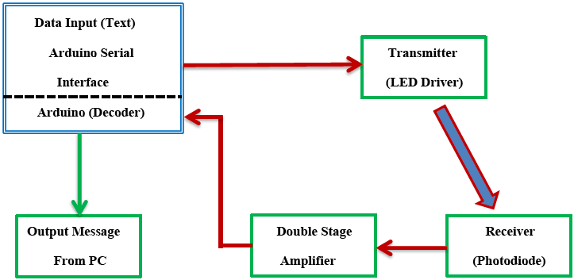
BLOCK DIAGRAM

Slide 7
BASIC WORKING PRINCIPLE
Transmitter: Encode data (e.g., text) into binary. Use an LED to flash light corresponding to the binary code (on/off representing 1/0).
Receiver: Use a photodiode or light-dependent resistor (LDR) to detect light variations and decode the signal back into data.
Arduino's Role: Both encoding/decoding the data and controlling the hardware.
STEPS TO IMPLEMENT
Data Encoding: Write a program to convert input data into binary format.
Light Modulation: Control the LED to blink at high speed to represent the binary data.
Data Reception: Set up the light sensor to detect variations in light intensity and send the received signal to the Arduino.
Decoding: Arduino processes the received binary signal and converts it back to readable data.

Slide 8
ADVANTAGES OF LIFI
High-speed data transmission with minimal interference.
Energy efficiency by utilizing LED light for dual purposes (illumination and communication).
Enhanced security as light cannot penetrate walls.
APPLICATIONS
Indoor communication systems.
Smart homes and IoT device connectivity.
Environments where RF communication is restricted, such as hospitals and airplanes.

Slide 9
REFERENCES
Haas, H. (2011). Wireless data from every light bulb. TED Global. [Presentation on the introduction of LiFi technology].
Pathak, P. H., Feng, X., Hu, P., & Mohapatra, P. (2015). Visible light communication, networking, and sensing: A survey, potential and challenges. IEEE Communications Surveys & Tutorials, 17(4), 2047-2077.
Saraswathi, S., Suresh, R., & Manoj, R. (2018). Arduino-based LiFi communication for data transmission. International Journal of Recent Technology and Engineering, 7(6), 43-47.
Raj, A., Kumar, S., & Singh, P. (2020). Integration of LiFi technology in IoT networks. IoT Journal, 4(2), 210-223.
Chowdhury, M., & Islam, S. (2021). A survey on optical wireless communication: Challenges and prospects. Journal of Optical Networking, 20(4), 302-320.
Gowri, A., & Reddy, M. K. (2016). LiFi-based data transmission using microcontrollers. International Journal of Wireless Technology, 5(3), 12-19.

